Slide 1
USA PERMANENT VISA STATUS PREDICTION

Slide 2
GROUP 3
Grishma Hari Vallabhi Kalidindi
Abhinay Bandi Naga
Akhila Penmetsa
Yesaswini Dandamudi
Sandesh Kumar Gattu
Hemantha Krishna Chandra Sekhar Chundi
Sanyasi Naidu Pyla
Nikhil Sarraf
Varsha Reddy Sripathi
Akhila Velaga

Slide 3

INTRODUCTION

Slide 4
BUSINESS USE CASE
The first and primary use case of this project is to build a model and observe trends in issuing permanent visas for H1B workers.
Secondly, we would like to find out the chances of getting Visa for applicants based on the industries they were working.
Finally, we will be creating a model to predict the chances of getting permanent visa for F1 Master’s students from top 5 countries.
Most of all, the above use cases and trends are helpful for US State Government to find out the deficiencies in their education system, the fields they are lacking and the growth in the respective fields by recruiting the foreign workers.

Slide 5
DATA
The data was taken from kaggle
It had 3,00,000 rows and 154 columns, which was preprocessed and reduced to around 1,00,000 records.
Records which had missing data and null values were discarded.
Some missing values were filled with average and mean values.

Slide 6
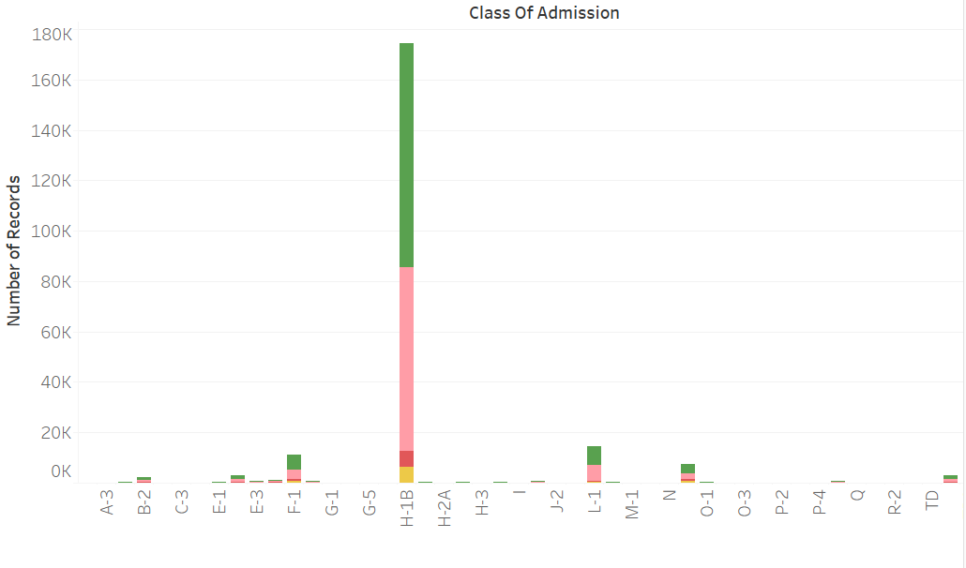
VISUALIZATIONS
The graph represents the number of records in each visa type. H1-B has almost 180,000 records being the highest. L-1 is the second highest, but only has 20,000 records.

Slide 7
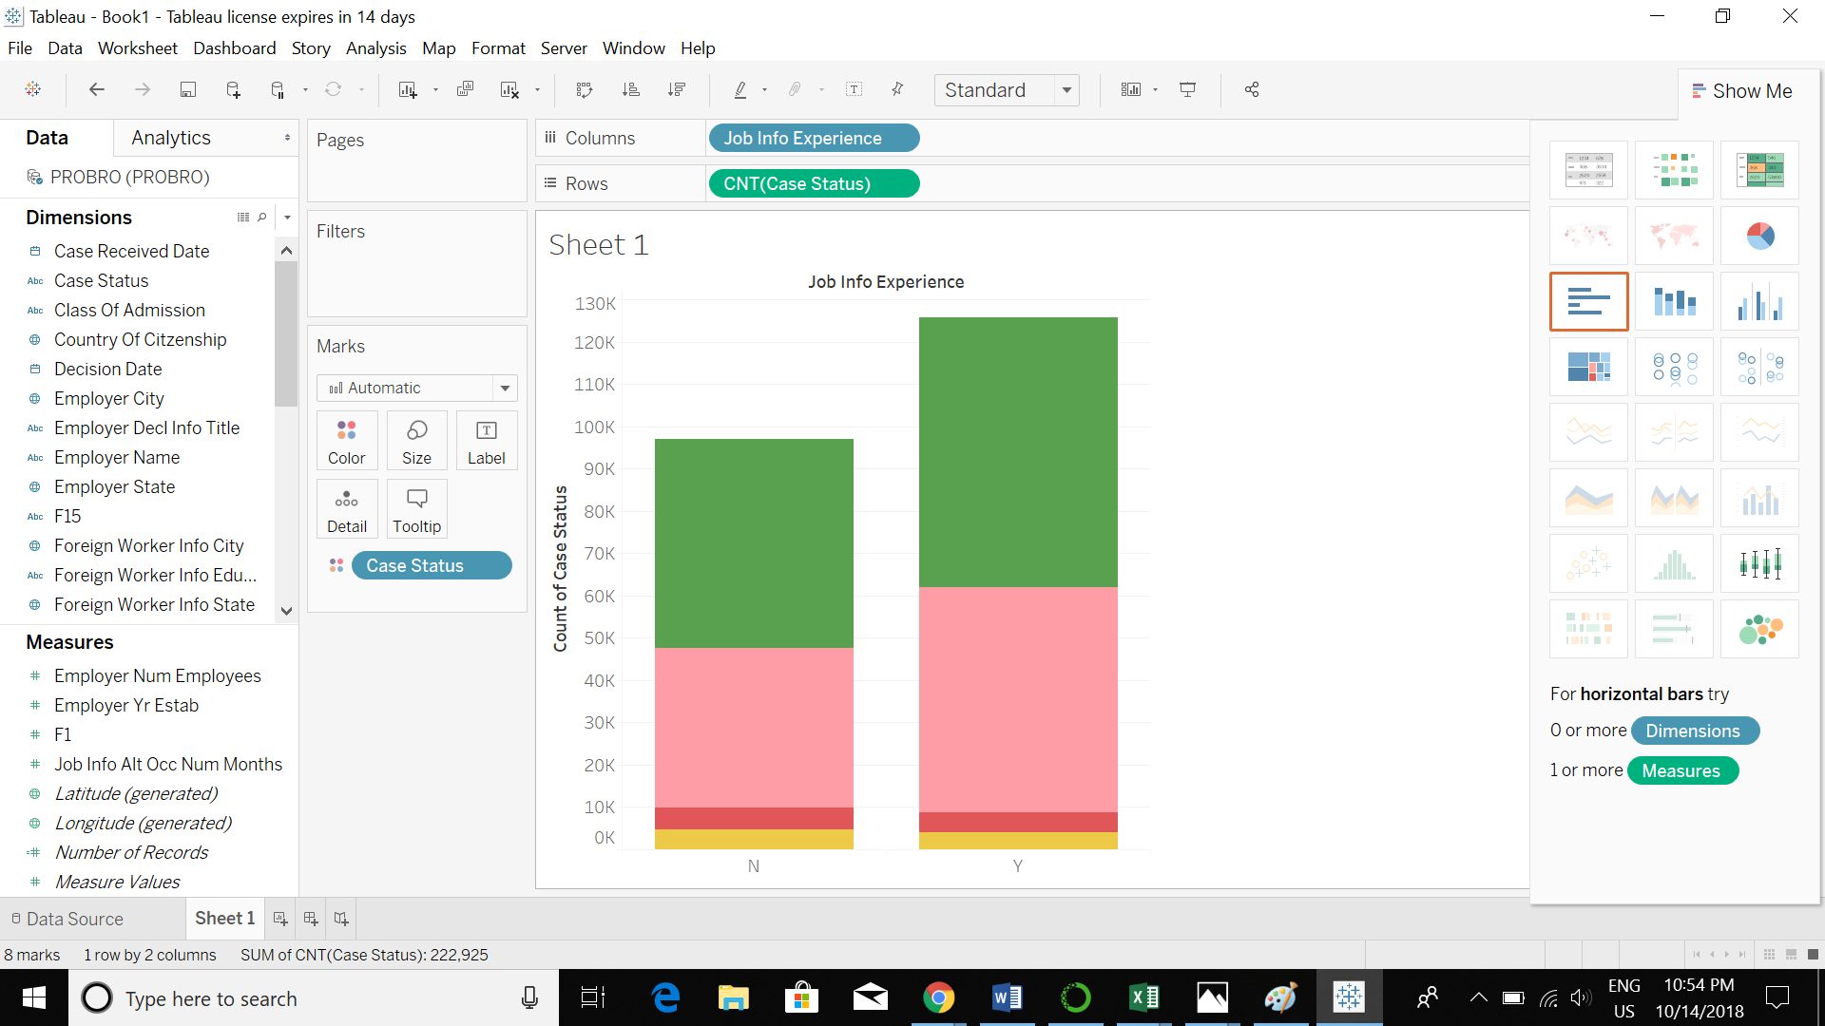
The graph shows the relationship between experience and case status.The applicants who have experience are depicted with label Y(yes) & those who don’t with label N(no). It can be observed that regardless of prior experience the percentage of case status remains the same.

Slide 8
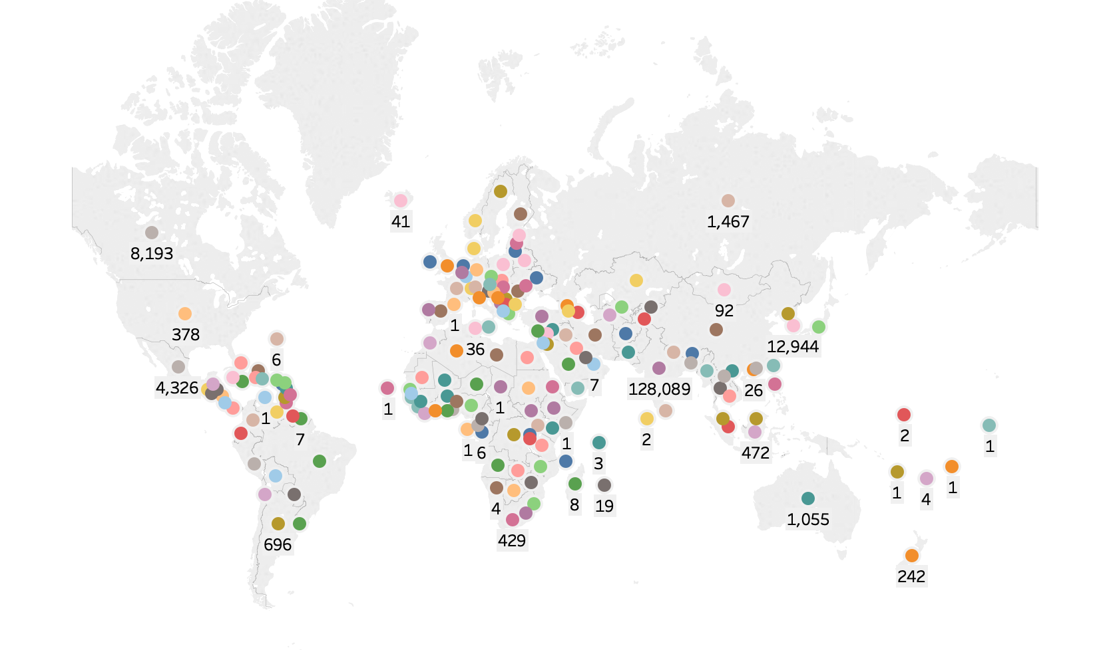
India has the highest number of visa applicants.

Slide 9
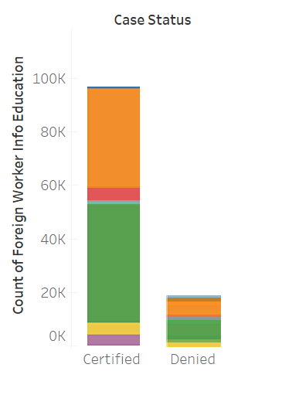
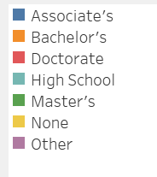
The graph depicts the association between the type of education and the visa status. It can be observed that Bachelor’s and Master’s are high in number.

Slide 10
HYPOTHESES:
1. Chance of getting permanent visa for F1 visa applicants pursuing masters and are citizens of top 5 countries in top 20 companies.
2. Chance of H-1B visa applicants getting a permanent visa, based on their country of citizenship, previous work experience, wages and their educational background.
3. Chance of getting permanent visa for the applicants based on the industry in which they are working.
4. Prediction of Number of days it takes for the decision to be made, once the application is filed. Applicants from the top 5 types of visa and top 6 country of citizenship have been chosen.

Slide 11
HYPOTHESIS-1
Chance of getting permanent visa for F1 visa applicants pursuing masters and are citizens of top 5 countries in top 20 companies.

Slide 12
DATA USED
Final no of records-5,326
Training -3,995, Validation-1,331
We filtered the top 20 companies data and also filter the F-1 student data and top 6 countries with highest applications

Slide 13
INDEPENDENT VARIABLES: DEPENDENT VARIABLES:
class_of_admission Case status.
case_status
job_info_education
Country_of_citizen
Employer_name

Slide 14
MODEL EVALUATION
Models used-Logistic Regression, Support Vector Machine,Voting Classifier, Random Forest.
Best Model- Random Forest Classifier.
Accuracy-89.3%

Slide 15
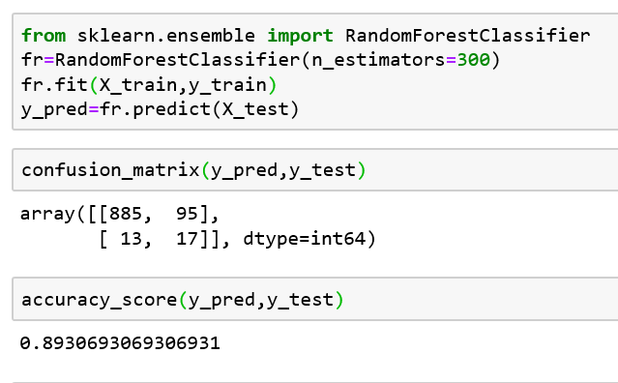
CODE

Slide 16
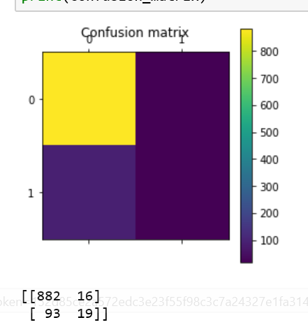
CONFUSION MATRIX

Slide 17
HYPOTHESIS -2
Estimating the chances of H-1B visa applicants getting a permanent visa, based on their country of citizenship, previous work experience, wages and their educational background.

Slide 18
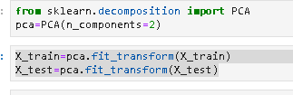
DATA USED
Final no of records-87,728
Training -56,796, Validation-21,932
PCA Analysis was done

Slide 19
INDEPENDENT VARIABLES: DEPENDENT VARIABLES:
class_of_admission Case Status
country_of_citizen
Employer_num_employees
Pw_level_9089
wage_offered_from_9089
Job_info_experience_num_months
Job_info_experience

Slide 20
MODEL EVALUATION
Models used-Logistic Regression, Support Vector, Random Forest Classification, Voting Classification.
Best Model-Logistic Regression
Accuracy - 93.18%

Slide 21
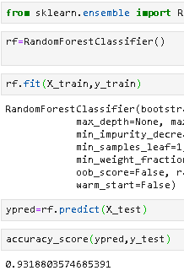
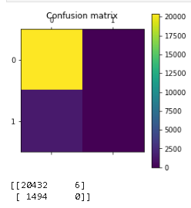
CODE AND CONFUSION MATRIX

Slide 22
HYPOTHESIS-3
Chance of getting permanent visa for the applicants based on the industry in which they are working.

Slide 23
DATA USED
Final no of records-28,421
Training -21,316, Validation-7,105
We filtered out the top 20 industries with the highest application count.

Slide 24
INDEPENDENT VARIABLES: DEPENDENT VARIABLES:
Naics_title Case status
Wage_offered_from_9089
Class_of_admission
Citizen
Job_info_experience
pw_level_9089
job_info_experience_num_months

Slide 25
MODEL EVALUATION
Models used- Random Forest Classification, Gradient Boosting Classifier, Logistic Regression, Bagging Classifier.
Best Model-Logistic Regression
Accuracy -94.23%

Slide 26
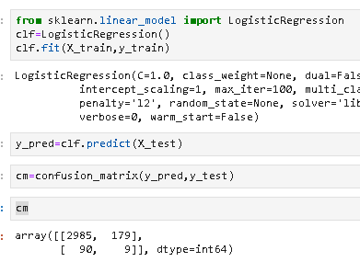
CODE

Slide 27
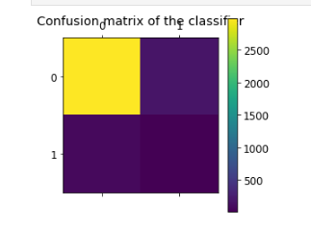
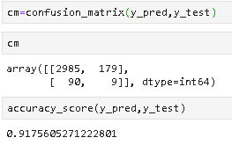
CONFUSION MATRIX

Slide 28
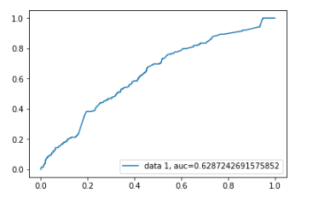
ROC CURVE

Slide 29
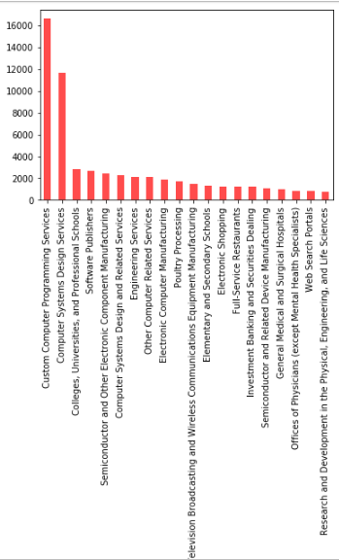
we Selected the Top 20 Industries which are having the highest number of applications.

Slide 30
HYPOTHESIS-4
Prediction of Number of days it takes for the decision to be made, once the application is filed. Applicants from the top 5 types of visa and top 6 country of citizenship have been chosen.

Slide 31
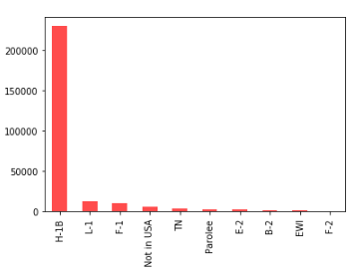
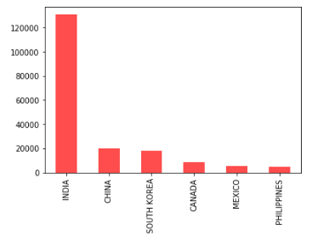
DATA USED
Final no of records-161,382
Training -121,037, Validation-40,345
Applicants from the top 5 types of visa and top 6 country of citizenship have been chosen.

Slide 32


We splitted the case_received_date into ‘Day’,’Month’,’Year’ columns and created a predicted variable column(‘Duration’) by subtracting the case_received_date and Decision_date.
Creating the Day,Month,Year columns

Slide 33
INDEPENDENT VARIABLES: DEPENDENT VARIABLES:
Case_recieved_date Duration
Decision_date
Year
Month
Day
Country_of_Citizen
Class_of_admission

Slide 34
MODEL EVALUATION FOR HYPOTHESIS-4
Models used- Linear Regression, Random Forest Regression, Support Vector Regression.
Best Model Random Forest Regression.
RMSE-71.

Slide 35
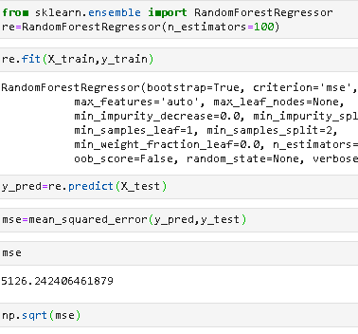
CODE

Slide 36
CONCLUSION
We can observe that there are many factors that are taken in to consideration for the certification of permanent visa, like the skill set of immigrants, the company they are applying for, experience in the field of study etc.
We’ve used different models like Logistic Regression, Support Vector Classification, Random Forest Classification, Voting classification and selected the best fit.
These methods will be helpful for the US government in the future to estimate the immigration statues and manage the number of permanent visas being issued.

Slide 37
Thank you

